Slide 1

When Developers Go Bad
Franklin Yamamoto
Franklin.yamamoto@sqlgrease.com
December 2018
Notes:
Drag and Drop your image and Send to back.

Slide 2
What do DBA's dislike most about their jobs?
Notes:
Data transaction units are a way to charge for resource consumption.

Slide 3
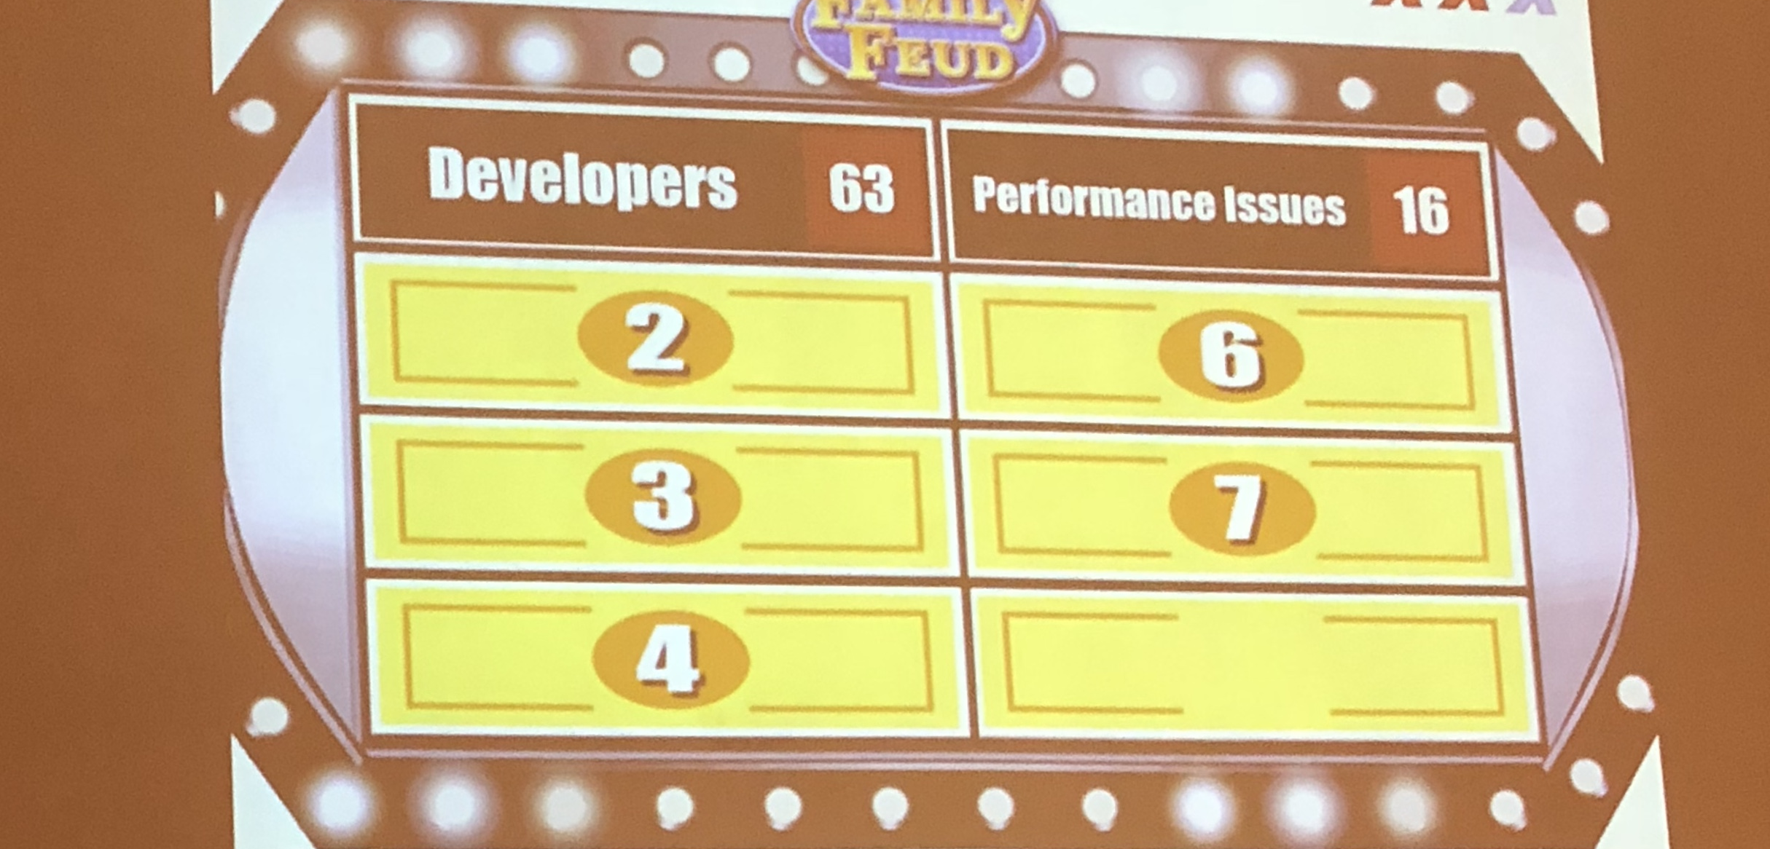

Slide 4





Have you ever had one of these conversations?
I know it's slow, can't you tune the database?
We ran it in staging and didn't have any problems?

Slide 5
Sometimes Coding Practices Cause Problems
Notes:
Data transaction units are a way to charge for resource consumption.

Slide 6

In this presentation I will...
Show several common performance problems caused by bad coding practices
Help you identify that these practices are going on from a DBA's perspective
Give you the information you need in order to communicate these problems and the fixes involved to developers

Slide 7
Implicit Conversions

Slide 8
What is an implicit conversion?
Implicit conversion occur when you compare two types that do not match
Implicit conversions do not always cause problems depending on datatype
One of the most problematic occurrences is with NVARCHAR, VARCHAR and NCHAR, CHAR

Slide 9

Our Test Table
CREATE TABLE [CustomerTest]
([CustomerID] [int],
[PersonID] [int] NULL,
[StoreID] [int] NULL,
[TerritoryID] [int] NULL,
[AccountNumber] varchar(10),
[rowguid] [uniqueidentifier] ROWGUIDCOL NOTNULL,
[ModifiedDate] [datetime] NOTNULL,
PRIMARYKEY([CustomerID]))
CREATE INDEX IX_Customer_AccountNumber ON CustomerTest(AccountNumber)

Slide 10
Our Test Query
SELECT * FROM CustomerTest WHERE AccountNumber = 'AW00000011'

Slide 11
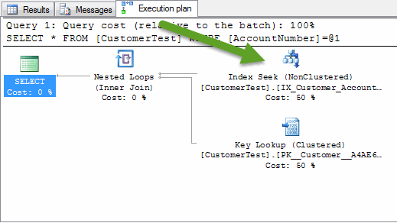

Slide 12
All looks good right?

Slide 13
Our Test Query Modified
SELECT * FROM CustomerTest WHERE AccountNumber = N'AW00000011'

Slide 14
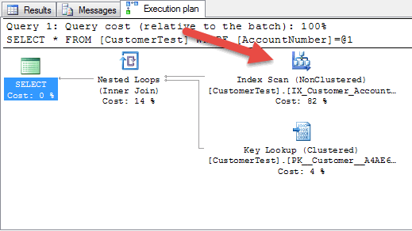

Slide 15
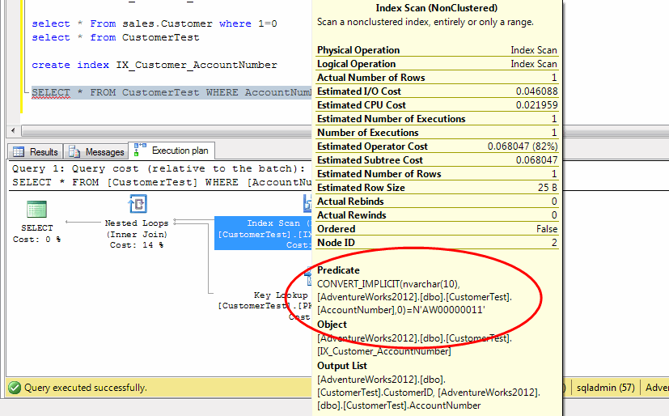

Slide 16
I’m not explicitly setting the N type in my query, so why does this example matter?

Slide 17

ADO.Net doesn't differentiate N types.
The String datatype used by .Net is always Unicode.
When passing .Net String datatypes to the database they are sent as N types automatically.
This is default behavior so maybe our developers aren't so misguided.
This can easily be prevented by specifying the proper type when passing Strings to the database.

Slide 18
Bad code
SqlCommand command = new SqlCommand()
command.CommandText = "SELECT * FROM CustomerTest WHERE AccountNumber = @AccountNumber";
command.Parameters.Add(new SqlParameter("@AccountNumber","AW00000011"));

Slide 19
Good code
SqlCommand command = new SqlCommand()
SqlParameter parameter = new SqlParameter("@AccountNumber", System.Data.SqlDbType.VarChar);
parameter.Value = "AW00000011";
command.Parameters.Add(parameter);

Slide 20
Find these by plan warnings
--Credit Brent Ozar
SELECT st.text,
qp.query_plan
FROM (
SELECT TOP 50 *
FROM sys.dm_exec_query_stats
ORDER BY total_worker_time DESC
) AS qs
CROSS APPLY sys.dm_exec_sql_text(qs.sql_handle) AS st
CROSS APPLY sys.dm_exec_query_plan(qs.plan_handle) AS qp
WHERE qp.query_plan.value('declare namespace p="http://schemas.microsoft.com/sqlserver/2004/07/showplan";count(//p:Warnings)', 'int') > 0

Slide 21
Common Implicit Conversion Types
Input Data Type | Table Data Type | Implicit Conversion
NVARCHAR | VARCHAR | YES
NCHAR | CHAR | YES
VARCHAR | NVARCHAR | NO
CHAR | NCHAR | NO
INT,BIGINT | NVARCHAR | YES
INT,BIGINT | NCHAR | YES
INT,BIGINT | CHAR | YES
NVARCHAR | INT,BIGINT | NO
NCHAR | INT,BIGINT | NO
VARCHAR | INT,BIGINT | NO
CHAR | INT,BIGINT | NO

Slide 22
Serializable Transactions

Slide 23
What is a Serializable Transaction?
A serializable transaction will cause a select to leave locks on the data selected until the transaction is committed or rolled back.
Most applications should be able to run with read committed as a transaction isolation level.

Slide 24
Find these by executing requests
SELECT st.text, er.* FROM sys.dm_exec_requests er
CROSS APPLY sys.dm_exec_sql_text(er.sql_handle) st
WHERE er.transaction_isolation_level = 4

Slide 25
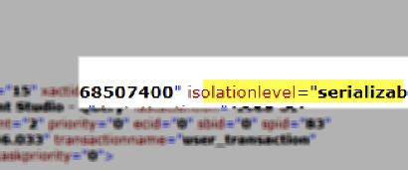
Find these by deadlocks

Slide 26
My developers insist they are using the ADO.Net default of read committed. Ask if they are using TransactionScope?

Slide 27
TransactionScope defaults to Serializable
// This code will include any SQL wrapped in the {}
// in a Serializable Transaction
using (TransactionScope scope = new TransactionScope())
{...}

Slide 28
Don't use default behavior
// This code will use a ReadCommitted transaction
TransactionOptions transactionOptions = new TransactionOptions();
transactionOptions.IsolationLevel = IsolationLevel.ReadCommitted;
using (TransactionScope scope = new TransactionScope(TransactionScopeOption.Required, transactionOptions))
{...}

Slide 29
Leaked Connections

Slide 30
What is a Leaked
Connection?
A leaked connection occurs when code does not correctly close/dispose of a SQLConnection object or SQLDataReader object.
ADO.NET connection pools by default. Leaking connections will cause a pool to fill up and eventually will lead to slow connection opening or errors.

Slide 31
Typical error message on application servers
Message=Timeout expired. The timeout period elapsed prior to obtaining a connection from the pool. This may have occurred because all pooled connections were in use and max pool size was reached.

Slide 32
This is an application issue. Why should I be concerned about it from a database perspective?

Slide 33
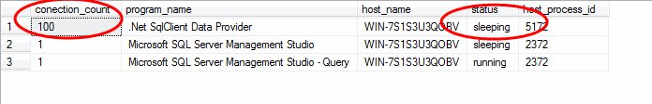
How to check it this is possibly affecting you?
select count(1) conection_count, program_name, host_name, status, host_process_id
from sys.dm_exec_sessions where is_user_process = 1
group by program_name, host_name, status, host_process_id order by 1 desc

Slide 34
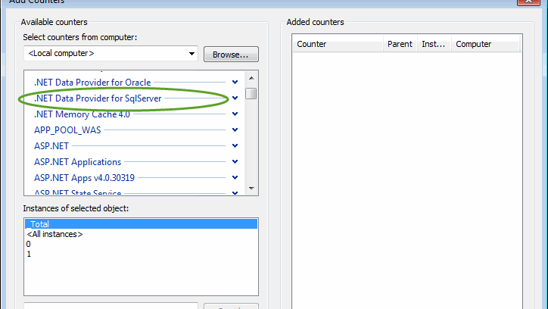

Slide 35
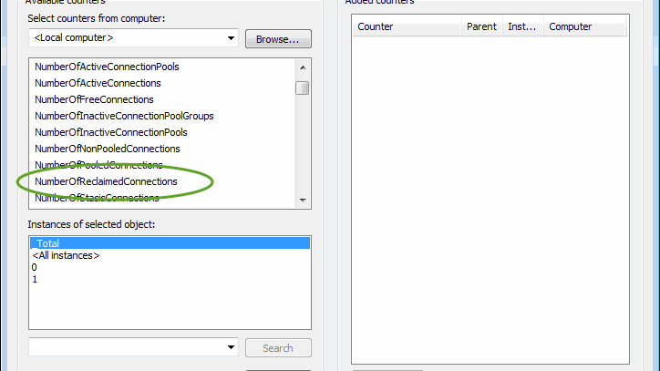

Slide 36
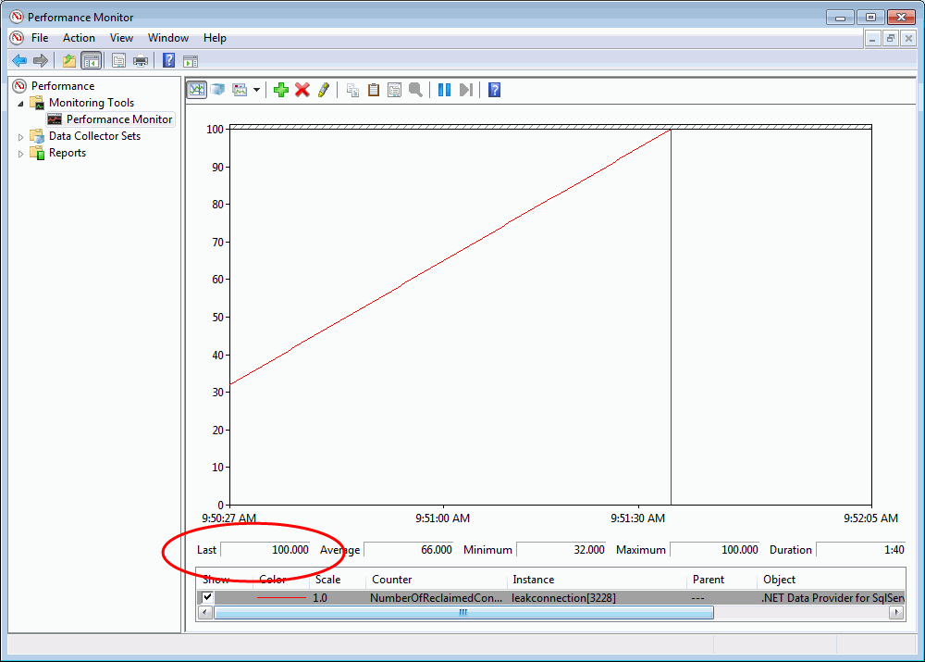

Slide 37
How to find the source of leaks?
DECLARE @host_name nvarchar(128)
DECLARE @host_process_id int
SET @host_name = 'WIN-7S1S3U3QOBV'
SET @host_process_id = 6056
SELECT top 100 s.last_request_end_time,
datediff(ss, s.last_request_end_time, getdate()) seconds_since_last_request_ended,
s.session_id, c.most_recent_sql_handle,
COALESCE(st.text, N'Statement no longer in cache') statement_text
FROM sys.dm_exec_sessions s
INNER JOIN sys.dm_exec_connections c ON
s.session_id = c.session_id
OUTER APPLY sys.dm_exec_sql_text(c.most_recent_sql_handle) st
WHERE s.is_user_process=1
AND s.host_name = @host_name AND s.status = 'sleeping'
ORDER BY last_request_end_time

Slide 38
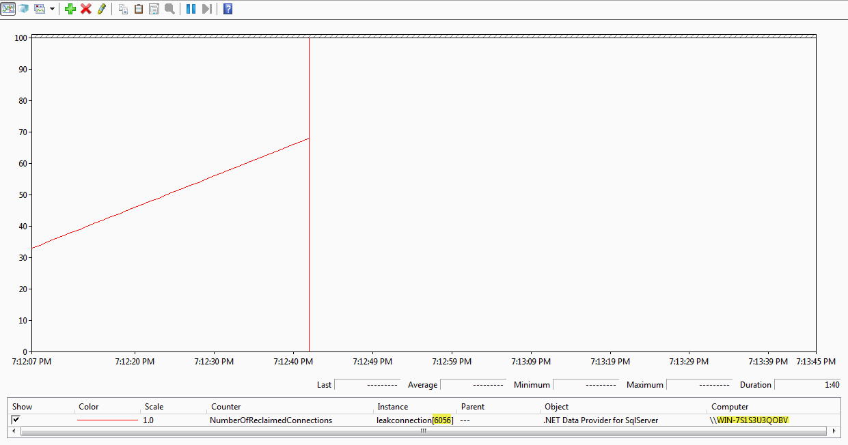

Slide 39
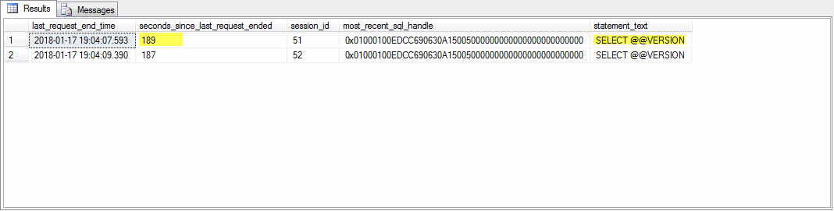

Slide 40
.Net Command Timeouts

Slide 41
What are
Command Timeouts?
.Net Command timeouts occur (by default) after 30 seconds. This is the result of an application terminating an executing request.
These aren't limited to coming from .Net, they also come from other processes such as SSMS.
It is good to track these in the database.

Slide 42
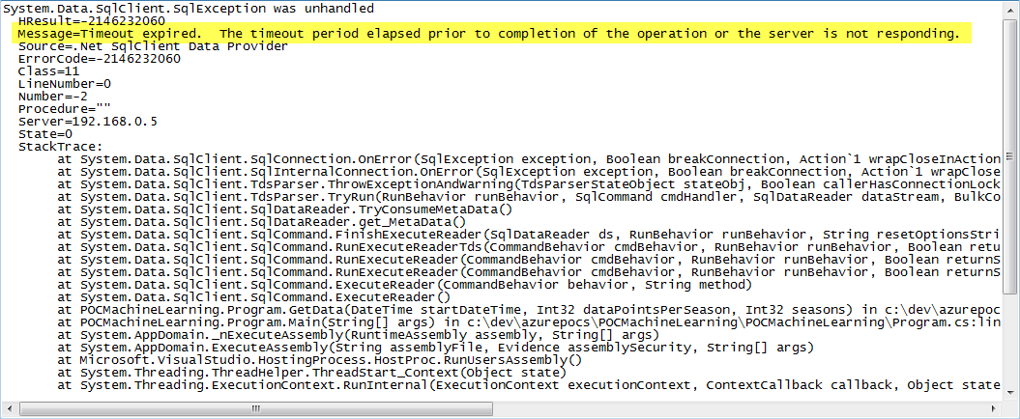

Slide 43
The simplest way to track them is via an extended event.
CREATE EVENT SESSION execution_timeout ON SERVER
ADD EVENT sqlserver.attention
(ACTION (sqlserver.session_id, sqlserver.database_id, sqlserver.database_name,
sqlserver.username, sqlserver.sql_text, sqlserver.client_hostname,
sqlserver.client_app_name)
WHERE ([package0].[equal_boolean]([sqlserver].[is_system],(0))))
ADD TARGET package0.event_file(SET filename=N'execution_timeout.xel',
max_file_size=(5),max_rollover_files=(2))
ALTER EVENT SESSION execution_timeout ON SERVER STATE = start

Slide 44
Querying the extended event data collected:
SELECT
object_name, convert(xml,event_data), file_name, file_offset
FROM sys.fn_xe_file_target_read_file(N'execution_timeout*.xel',
NULL,NULL,NULL)

Slide 45
".Net SqlClientData Provider"

Slide 46
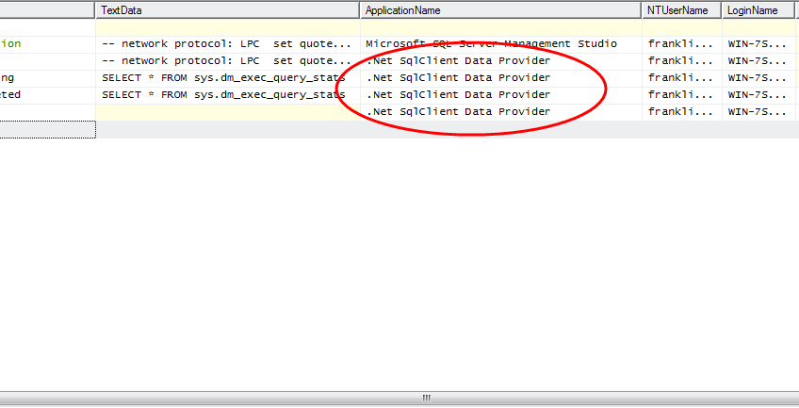

Slide 47
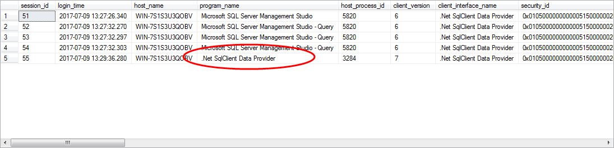
Typical output of sys.dm_exec_sessions
select * from sys.dm_exec_sessions s where s.session_id != @@spid and s.is_user_process = 1

Slide 48
Just set the application name in the connection string
"Integrated Security = true;server=localhost\\sql2012;"
"Integrated Security = true;server=localhost\\sql2012; Application Name=MyDotNetApplication"

Slide 49
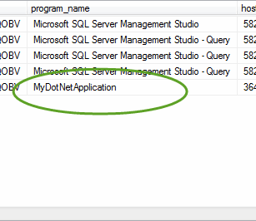
Typical output of sys.dm_exec_sessions
select * from sys.dm_exec_sessions s where s.session_id != @@spid and s.is_user_process = 1

Slide 50
Single Use Execution Plans

Slide 51
What are single use plans?
Single use plans are generated from non-parameterized SQL
Many times the SQL can be parameterized, but it requires code changes
Single use plans not only clutter the plan cache but introduce a performance impact due to frequent compilations
On some occasions simple parameterization will do this

Slide 52
Run the following to find single use plans.
create table #single_use_plan_handles
(plan_handle varbinary(64),
size_in_bytes int
)
insert into #single_use_plan_handles
select plan_handle, size_in_bytes
from sys.dm_exec_cached_plans where usecounts = 1
select count(1) number_of_queries, query_hash,
sum(convert(bigint,size_in_bytes)) size_in_cache_bytes,
max(size_in_bytes) size_of_each_bytes
from sys.dm_exec_query_stats a inner join #single_use_plan_handles b
on a.plan_handle = b.plan_handle group by query_hash having count(1) > 1 order by 3 desc
drop table #single_use_plan_handles

Slide 53
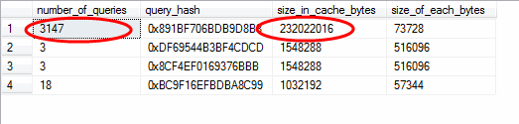
3147 queries 232 MB in cache

Slide 54
Replace the query_hash in the query below to view the queries.
select top 10
text from sys.dm_exec_query_stats a
cross apply sys.dm_exec_sql_text(a.sql_handle) b
where a.query_hash = 0x891BF706BDB9D8B8

Slide 55
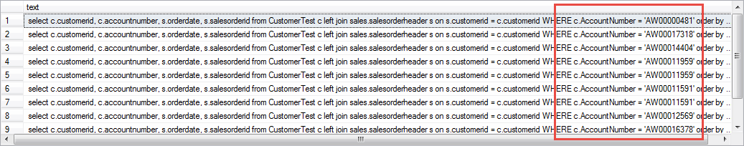
These are all the same query, they only differ by parameters.

Slide 56
Rather than optimize for adhoc workload fix with template plan guide
USE AdventureWorks2012
DECLARE @stmt nvarchar(max);
DECLARE @params nvarchar(max);
EXEC sp_get_query_template
N'select c.customerid, c.accountnumber, s.orderdate, s.salesorderid from CustomerTest c left join sales.salesorderheader s on s.customerid = c.customerid WHERE c.AccountNumber = ''AW00000481'' order by s.orderdate',
@stmt OUTPUT,
@params OUTPUT
EXEC sp_create_plan_guide N'LookupCustomerOrderTemplate',
@stmt,
N'TEMPLATE',
NULL,
@params,
N'OPTION(PARAMETERIZATION FORCED)';

Slide 57
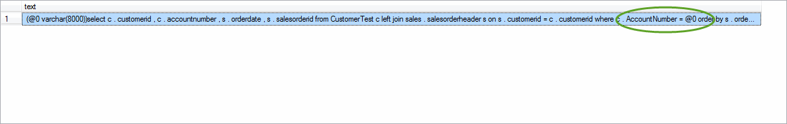
Query text is now showing a parameterized query

Slide 58

Query no longer has a single use plan

Slide 59

Thank You
Franklin.yamamoto@sqlgrease.com
Notes:
Drag and Drop your image and Send to back.

